Slide 1
ForecastX: Time Series Stock Analysis & Prediction
Guided by: Dr. Monika Bhattacharjee
Name: kunjbihari
Roll. : 24n0081

Slide 2
Overview
Interactive dashboard built with Streamlit
Uses ARIMA & SARIMA for stock forecasting
Manual and automated hyperparameter tuning
Empowers traders with clear, actionable insights
Stock Analysis Module (Features)
Enter any stock ticker and date range
Company profile: sector, employees, website
Financial metrics & ratios (Market Cap, EPS, PE, etc.)
Visualizations: Candlestick chart, MACD, RSI, Bollinger Bands
Historical price data table

Slide 3
Prediction Module (Workflow)
Choose ARIMA or SARIMA model
Configure rolling mean, training years, model parameters
Manual parameter input or Grid Search hyperparameter tuning
Fetch and preprocess data with rolling mean smoothing
Model trained on historical data, validated with last 30 days
Model Validation and Metrics
Validation period: 30 business days held out
Metrics shown: MSE, RMSE, MAE, MAPE
Analytics: Latest close price, historical mean, volatility
Example: AAPL SARIMA Grid Search results
RMSE: 15.28
MAPE: 4.7%
MSE: 115.42
MAE:9.84

Slide 4
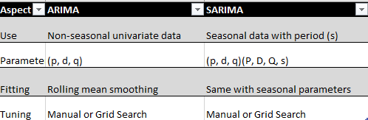
Forecast Output
Holdout period forecast with confidence intervals
Next 30 days forecast with lower and upper bounds
Downloadable CSVs for validation and forecast data
Combined plot of actual, validation, and forecasted prices
Technical Summary

Slide 5
Insights and Recommendations
SARIMA effective for seasonal stocks; ARIMA simpler for others
Grid search tuning recommended for best accuracy
Visualize validation metrics for model confidence
Explore technical indicators for trading signals
Conclusion
ForecastX provides a comprehensive ARIMA/SARIMA forecasting toolkit
Combines robust analytics and user-friendly design
Supports manual expertise and automated optimization
Enhances trader decision-making with transparent, validated forecasts

Slide 6
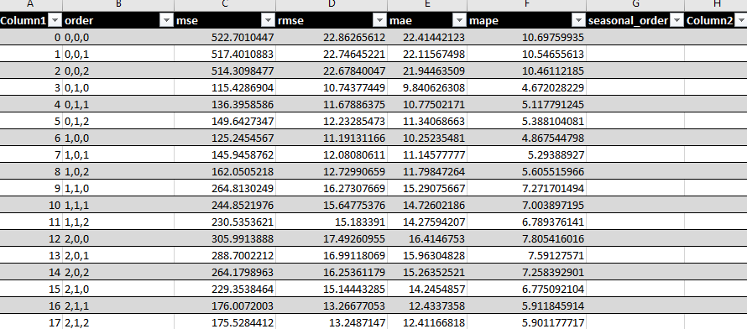
Appendix
Hypertuning for ARIMA

Slide 7
Thank you Ma’am

